Slide 1

Chapter Four: Artificial Neural Networks (ANN)
CSCE 5380/4380 – Data Mining

Slide 2
Outline
ANN – Basic Idea & Definition
ANN - Perceptron
Multi-layer Neural Networks
Design Issues & Characteristics of ANN
Deep Learning Trends
Introduction to Data Mining, 2nd Edition

Slide 3
Artificial Neural Networks (ANN)
Basic Idea: A complex non-linear function can be learned as a composition of simple processing units
ANN is a collection of simple processing units (nodes) that are connected by directed links (edges)
Every node receives signals from incoming edges, performs computations, and transmits signals to outgoing edges
Analogous to human brain where nodes are neurons and signals are electrical impulses
Weight of an edge determines the strength of connection between the nodes
As in biological neural systems, the primary objective of ANN is to adapt the weights of the links until they fit the input-output relationships of the underlying data.
Simplest ANN: Perceptron (single neuron)

Slide 4
Basic Architecture of Perceptron
Activation Function
Learns linear decision boundaries
Related to logistic regression (activation function is sign instead of sigmoid)

Slide 5
Perceptron Example
Output Y is 1 if at least two of the three inputs are equal to 1.

Slide 6
Perceptron Example

Slide 7
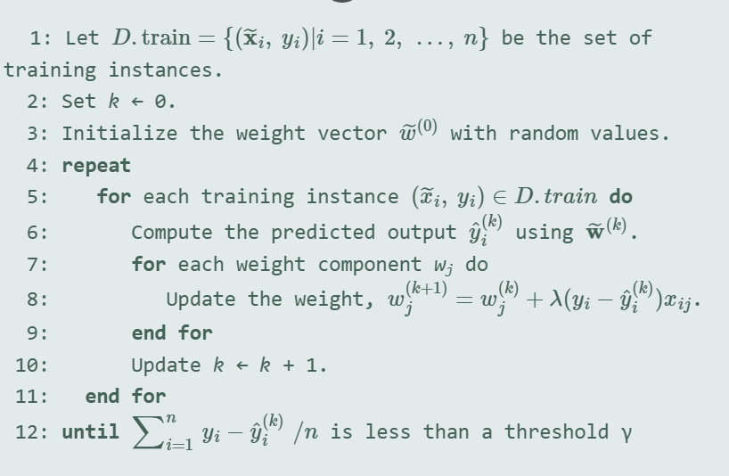
Perceptron: Algorithm

Slide 8
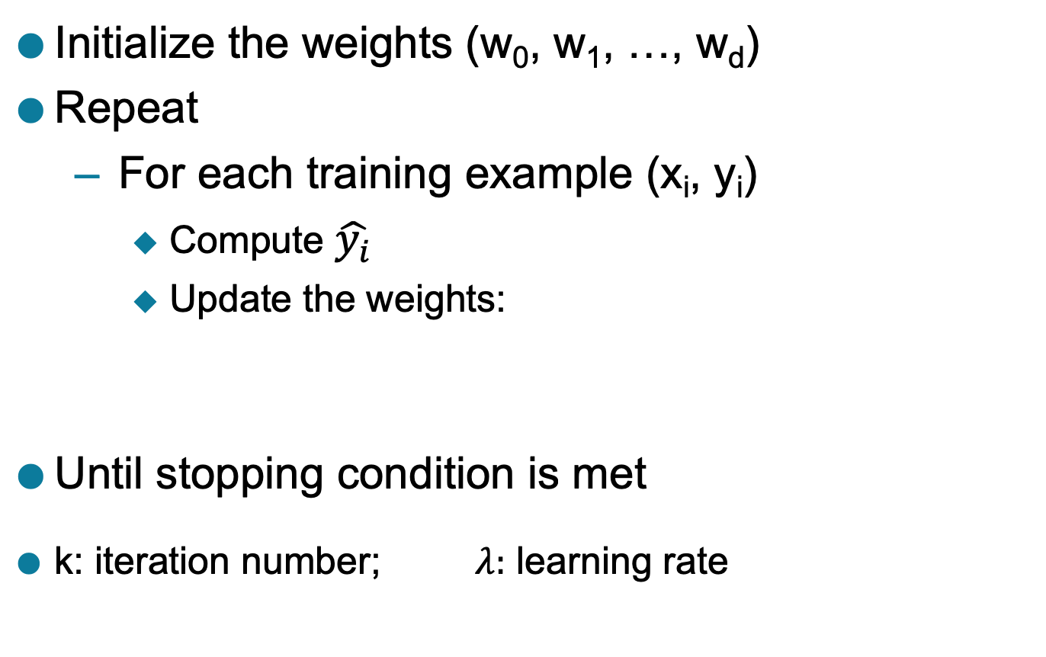
Perceptron Learning Rule
Initialize the weights (w₀, w₁, …, w_{d})
Repeat
For each training example (x_{i}, y_{i})
Compute $\hat{y_{i}}$
Update the weights:
Until stopping condition is met
k: iteration number; $λ:$ learning rate

Slide 9
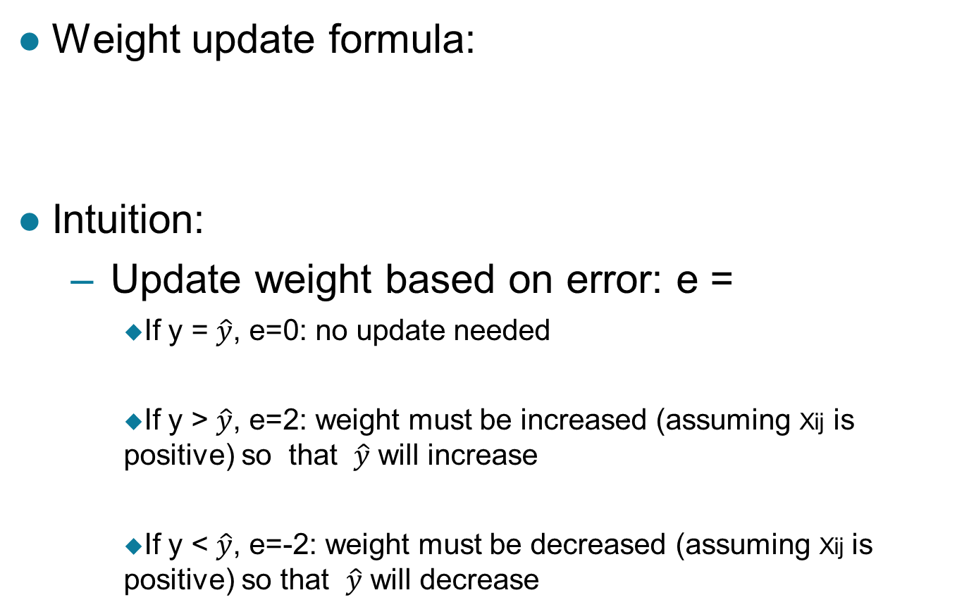
Perceptron Learning Rule
Weight update formula:
Intuition:
Update weight based on error: e =
If y = $\hat{y}$, e=0: no update needed
If y > $\hat{y}$, e=2: weight must be increased (assuming Xij is positive) so that $\hat{y}$ will increase
If y < $\hat{y}$, e=-2: weight must be decreased (assuming Xij is positive) so that $\hat{y}$ will decrease

Slide 10
Example of Perceptron Learning
Weight updates over all epochs
Weight updates over first epoch

Slide 11
Perceptron Learning
Since y is a linear combination of input variables, decision boundary is linear

Slide 12
Nonlinearly Separable Data
For nonlinearly separable problems, perceptron learning algorithm will fail because no linear hyperplane can separate the data perfectly
XOR Data

Slide 13
Multi-layer Neural Network
More than one hidden layer of computing nodes
Every node in a hidden layer operates on activations from preceding layer and transmits activations forward to nodes of next layer
Also referred to as “feedforward neural networks”
Notes:
Hidden layers represent levels of abstraction. ANN models provide a natural way of representing features at multiple levels of abstraction, where complex features are seen as compositions of simpler features. In many classification problems, modeling such a hierarchy of features turns out to be very useful. For example, in order to detect a human face in an image, we can first identify low-level features such as sharp edges with different gradients and orientations. These features can then be combined to identify facial parts such as eyes, nose, ears, and lips. Finally, an appropriate arrangement of facial parts can be used to correctly identify a human face. ANN models provide a powerful architecture to represent a hierarchical abstraction of features, from
k lower levels of abstraction (e.g., edges) to higher levels (e.g., facial parts).

Slide 14
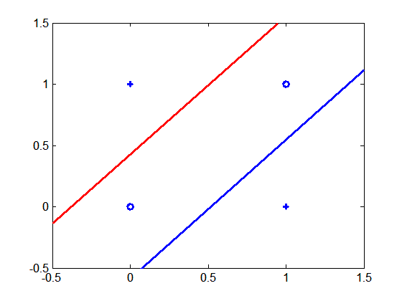
Multi-layer Neural Network
Multi-layer neural networks with at least one hidden layer can solve any type of classification task involving nonlinear decision surfaces
XOR Data

Slide 15
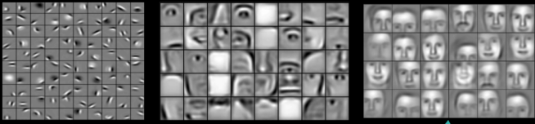
Why Multiple Hidden Layers?
Activations at hidden layers can be viewed as features extracted as functions of inputs
Every hidden layer represents a level of abstraction
Complex features are compositions of simpler features
Number of layers is known as depth of ANN
Deeper networks express complex hierarchy of features
Notes:
ANN models provide a natural way of representing features at multiple levels of abstraction, where complex features are seen as compositions of simpler features. In many classification problems, modeling such a hierarchy of features turns out to be very useful. For example, in order to detect a human face in an image, we can first identify low-level features such as sharp edges with different gradients and orientations. These features can then be combined to identify facial parts such as eyes, nose, ears, and lips. Finally, an appropriate arrangement of facial parts can be used to correctly identify a human face. ANN models provide a powerful architecture to represent a hierarchical abstraction of features, from
k lower levels of abstraction (e.g., edges) to higher levels (e.g., facial parts).

Slide 16
Multi-Layer Network Architecture
Activation value at node i at layer l
Activation Function
Linear Predictor

Slide 17
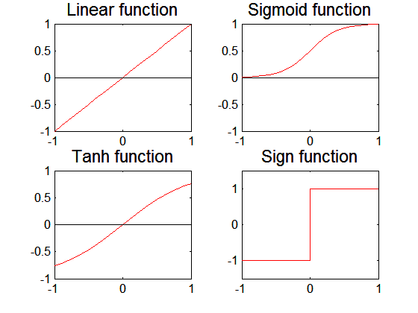
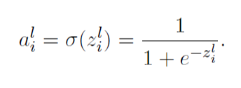
Activation Functions

Slide 18
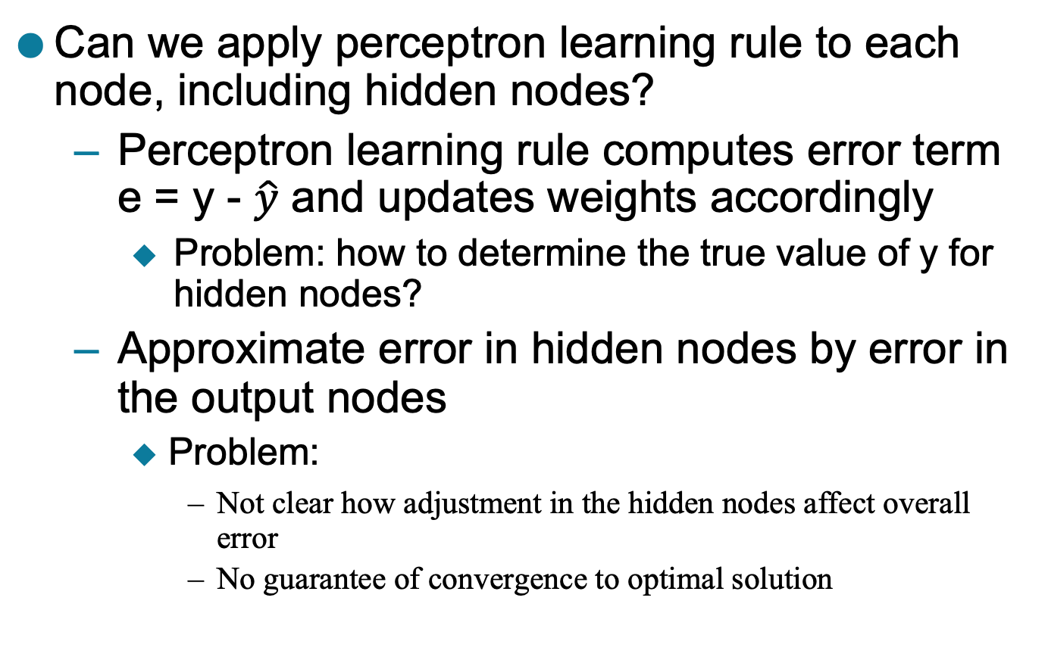
Learning Multi-layer Neural Network
Can we apply perceptron learning rule to each node, including hidden nodes?
Perceptron learning rule computes error term e = y - $\hat{y}$ and updates weights accordingly
Problem: how to determine the true value of y for hidden nodes?
Approximate error in hidden nodes by error in the output nodes
Problem:
Not clear how adjustment in the hidden nodes affect overall error
No guarantee of convergence to optimal solution

Slide 19
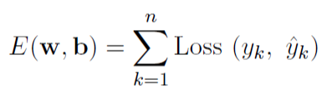

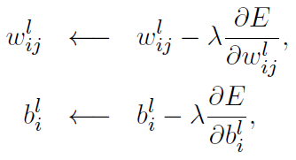

Gradient Descent
Loss Function to measure errors across all training points
Gradient descent: Update parameters in the direction of “maximum descent” in the loss function across all points
Stochastic gradient descent (SGD): update the weight for every instance (minibatch SGD: update over min-batches of instances)
Squared Loss:
$λ$: learning rate

Slide 20
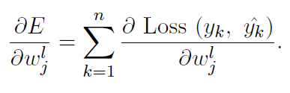

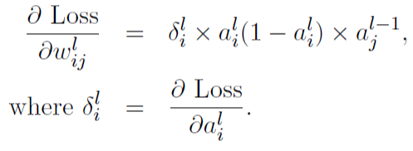




Computing Gradients
$$\hat{y}=a^{L}$$
Using chain rule of differentiation (on a single instance):
For sigmoid activation function:
How can we compute $δ_{i}^{l}$ for every layer?
$$ij$$
$$ij$$

Slide 21
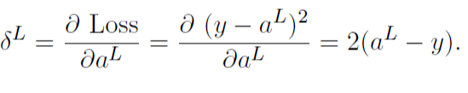
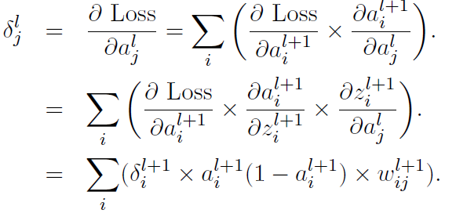
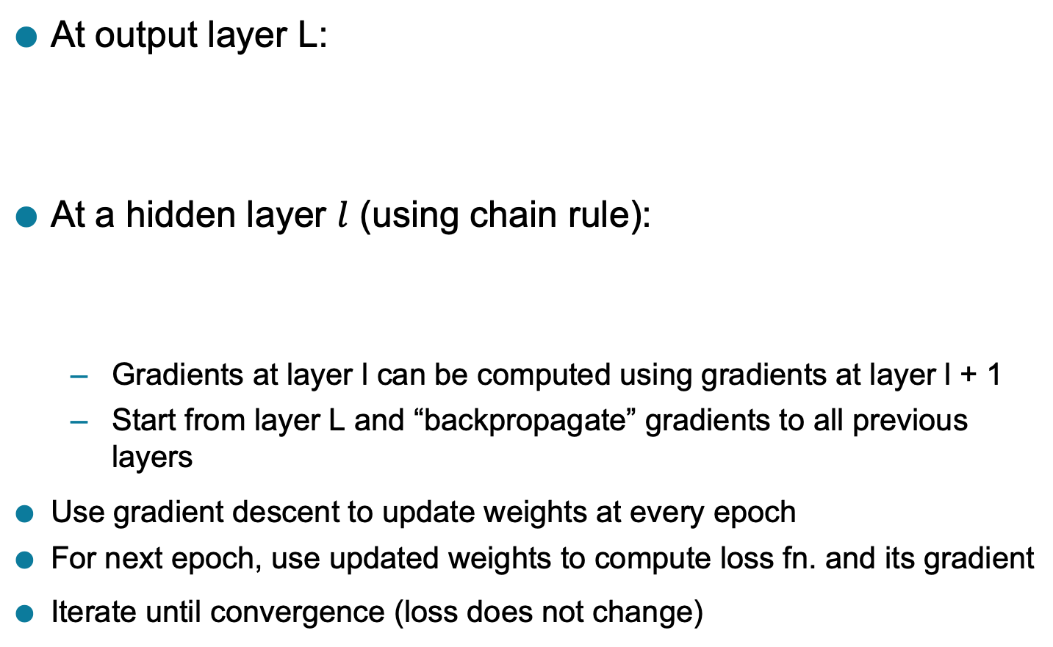
Backpropagation Algorithm
At output layer L:
At a hidden layer $l$ (using chain rule):
Gradients at layer l can be computed using gradients at layer l + 1
Start from layer L and “backpropagate” gradients to all previous layers
Use gradient descent to update weights at every epoch
For next epoch, use updated weights to compute loss fn. and its gradient
Iterate until convergence (loss does not change)

Slide 22
Design Issues in ANN
Number of nodes in input layer
One input node per binary/continuous attribute
k or log₂ k nodes for each categorical attribute with k values
Number of nodes in output layer
One output for binary class problem
k or log₂ k nodes for k-class problem
Number of hidden layers and nodes per layer
Initial weights and biases
Learning rate, max. number of epochs, mini-batch size for mini-batch SGD, …

Slide 23
Characteristics of ANN
Multilayer ANN are universal approximators but could suffer from overfitting if the network is too large
Naturally represents a hierarchy of features at multiple levels of abstractions
Gradient descent may converge to local minimum
Model building is compute intensive, but testing is fast
Can handle redundant and irrelevant attributes because weights are automatically learnt for all attributes
Sensitive to noise in training data
This issue can be addressed by incorporating model complexity in the loss function
Difficult to handle missing attributes

Slide 24
Deep Learning Trends
Training deep neural networks (more than 5-10 layers) could only be possible in recent times with:
Faster computing resources (GPU)
Larger labeled training sets
Algorithmic Improvements in Deep Learning
Responsive activation functions (e.g., RELU)
Regularization (e.g., Dropout)
Supervised pre-training
Unsupervised pre-training (auto-encoders)
Specialized ANN Architectures:
Convolutional Neural Networks (for image data)
Recurrent Neural Networks (for sequence data)
Residual Networks (with skip connections)
Generative Models: Generative Adversarial Networks

